Slide 1

CA State Preschool Program (CSPP)
Registration Instructions
STEP 1: CHECK BIRTHDATE
Child must be 3 years old for enrollment
December 2, 2025 - December 1, 2026
(Birthdate would be December 2, 2022 - December 1, 2023)
Child must turn 4 years old between
December 2, 2025 - December 1, 2026
(Birthdate would be December 2, 2021 - December 1, 2022)
STEP 2: CHECK ELIGIBILITY- Based on ONE of the following:
Child Protective Services or Child Identified as At-Risk
Documentation Required: Written referral, dated within six months of application for services
Homelessness
Documentation Required: Written referral or self declaration that the family is homeless with a statement describing the family’s living situation
Child with Exceptional Needs
Documentation Required: Copy of child’s active Individualized Education Plan (IEP)
Currently Receiving Governmental Benefits
Documentation Required: Enrollment paperwork dated within the last year and Program Application, or self-declaration of income declared on the application. Examples: Medi-Cal, CalWorks, WIC, Head Start, CalFresh
Income Eligible
Documentation Required:
Regular Income- Monthly pay stubs (2) from previous 60 days (all parents/guardians)
Fluctuating Income- Last 12 months
Self-employed- Two current months profit/loss and most current income tax return including Schedule C
STEP 3: FAMILY APPOINTMENT
Schedule an appointment one week from submission of application date and supporting documents online or by calling the school site.
STEP 4: DOCUMENTATION
Collect/complete the additional documentation to be brought to family meeting:
California State Preschool Program Application
Proof of Residence
Birth Certificates for every child in the home
Child’s immunization record
NOTE: Documentation Checklists include additional information to support required collection

Slide 2

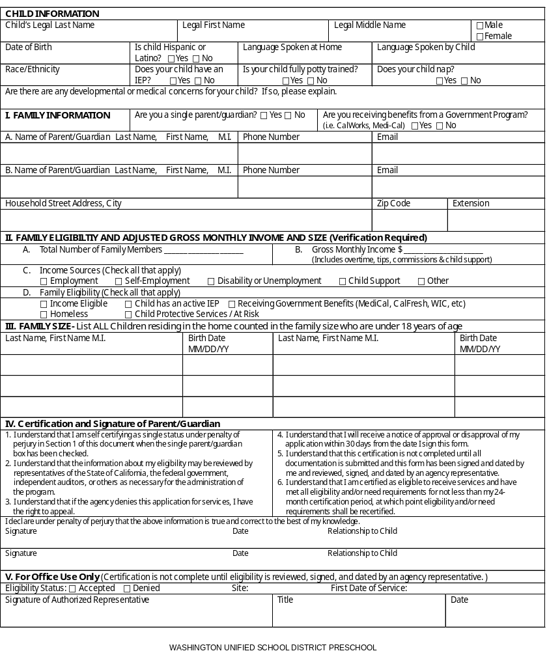
CALIFORNIA STATE PRESCHOOL
PROGRAM APPLICATION
CONFIDENTIAL APPLICATION FOR CHILD DEVELOPMENT SERVICES AND CERTIFICATION OF ELIGIBILITY

Slide 3

Documentation
Checklist (Page 1 of 2)
To ensure compliance with the requirements of our funder, California Department of Education, we must verify eligibility of each family participating in the Full-Day State Preschool Program. Please submit the following documents:
ELIGIBILITY VERIFICATION Documentation must be provided for 1 or more of these eligibility categories
Recipient of Child Protective Services or Child Identified as At-Risk
Self-Certification of Income AND
Referral Letter
Family Experiencing Homelessness
Self-Certification of Income AND
Referral Letter OR
Parental Declaration of Homelessness
Approved Neighborhood
School Boundary
Self-Certification of Income AND
Verification of Home Address (Example: Utility bill | Property tax bill | Voter registration | Rental/lease agreement | Government agency letter | Pay stub)
Child with Disabilities
Self-Certification of Income AND
Individual Family Services Plan (IFSP) OR
Individualized Education Program (IEP)
Receiving Benefits from Governmental Program
CalWORKs , Medi-Cal, CalFresh, California Food Assistance, California Special Supplemental Nutrition Program for Women, Infants and Children (WIC), Food Distribution Program on Indian Reservation, Head Start or Early Head Start.
Enrollment Documentation (Example: Notice of Action | Receipt of Aid | Verification of Benefits) AND
Copy of Governmental Program Application OR
If not available, Self-Declaration of Income as declared on the program application
Income Eligibility
Guardian or Foster Parent(s):
Documentation of Monthly Income (For child and their related siblings)
Biological or Adopted Parent(s):
Authorization to Release Employment Information (if applicable) AND
Parent Notification: Requirement to Report Income Over Threshold
Documentation of Monthly Income (ALL sources for ALL parents in family)
  Regular & Steady Income: Total countable income from either month of the 2-month window immediately preceding certification
  Fluctuating or Inconsistent Income: Total countable income from 12 months immediately preceding certification

Slide 4
Documentation
Checklist (Page 2 of 2)
FAMILY SIZE and
PRESCHOOL AGE VERIFICATION
At least 1 of the following documents must be provided for ALL children counted in family size:
Birth Certificate or other live birth records
Passport for Services from the county welfare department
Adoption documents or Records of Foster Care placement
Court orders regarding child custody or guardianship
RESIDENCY VERIFICATION
Proof that you live in the State of California:
Any evidence of your street address or post office box dated within the past 30 days
NEED FOR SERVICES
All adults must meet at-least 1 need criteria. Documentation to establish need is as follows:
Employment Verification
Declaration of Self-Employment & Supporting documents
Training Verification & Class Schedule
Educational Program Verification & Class Schedule
Request & Plan to Seek Employment
Statement of Incapacity
Request & Plan to Seek Permanent Housing
CPS, At-Risk or Homelessness Referral Letter
OTHER DOCUMENTATION
The following miscellaneous documents are also required:
Family Needs Request & Referral (to be completed at family appt.)
Family Language & Interest Instrument (to be completed at family appt.)
Court orders if they affect your childcare days/hours (If applicable)
CHILD CARE LICENSING DOCUMENTS | FORMS
If approved, ALL of the following documents/forms are required prior to first day of school:
Copy of child’s current immunization record
Identification & Emergency Information
Child’s Preadmission Health History – Parent/Authorized Representative Report (LIC 702)
Physician’s Report (LIC 701)
Notification of Parents’ Rights (LIC 995)
Personal Rights (LIC 613A)
Consent for Emergency Medical Treatment (LIC 627)

Slide 5
Submitting
Documents
PROCESS TO
SUBMIT DOCUMENTATION:
Submit completed application and supporting documentation via email or in person.
Email Application:
American Union (AU)
AUESregistration@wusd.ws
West Fresno Elementary (WFE)
WFESregistration@wusd.ws
In-person:
American Union (AU)
2801 W. Adams Ave. Fresno, 93706 (AU)
West Fresno Elementary (WFE)
2910 S. Ivy Ave. Fresno, 93706 (WFE)
Schedule an appointment online or by calling the school site.
(559) 495-5650 AU
(559) 495-5615 WFE
washingtonunified.org/wusdpreschool/
NOTE: Carefully review checklist located at the beginning of this packet to ensure all required documentation is submitted. Incomplete packets will delay the enrollment process.
Thank you for your interest in our Full-Day State Preschool program.

Slide 6
